Slide 1

HOSPITAL MANAGEMENT ANALYSIS
SQL CAPSTONE PROJECT DONE BY EIGBE FAVOUR OFURE

Slide 2
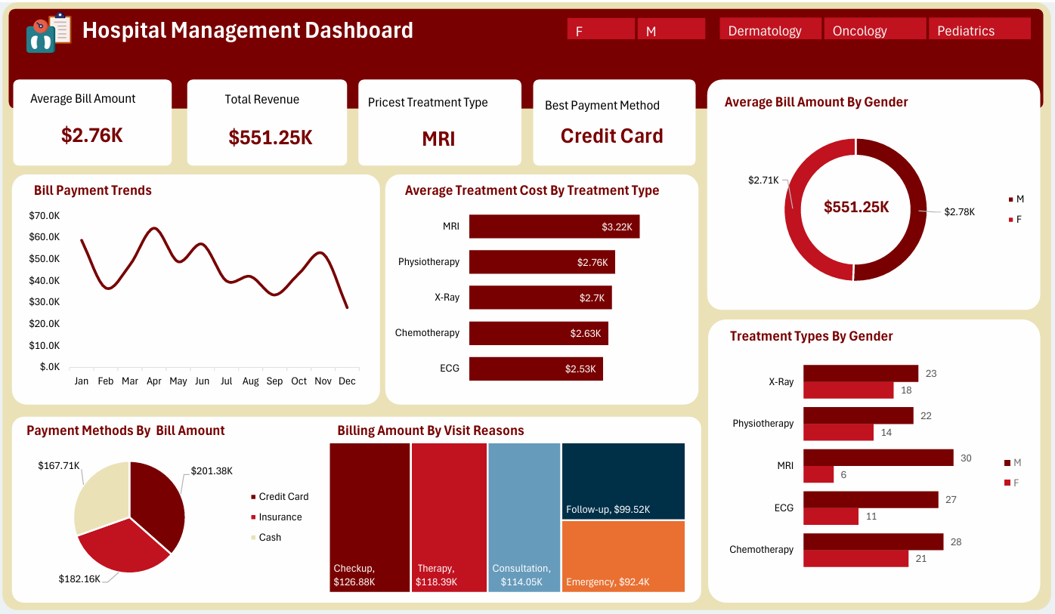
HOSPITAL MANAGEMENT ANALYSIS

Slide 3
INTRODUCTION
This project analyzes how the hospital is performing both financially and operationally through key metrics such as revenue, treatment costs, patient demographics and payment methods. It compares different treatment types, gender-based billing trends and monthly performance to identify areas of strength and opportunities for improvement. The global is to help stakeholders understand the relationship between service delivery and financial outcomes and to guide better decision making in hospital management and patient care.

Slide 4
OBJECTIVES
To analyze the financial and operational performance of the hospital across various treatment types, payment methos and patient demographics and to identify high and low performing areas to guide strategic decisions that enhance service efficiency, revenue generation and overall patient care

Slide 5
BUSINESS QUESTIONS
What are the trends in bill payments across months?
What is the average treatment cost per treatment type?
Does gender influence average bill amount?
Which payment method generated most payment?
Is there a difference in billing between visit reasons (e.g., emergency vs consultation)?
How frequently do patients of different genders attend specific treatments?

Slide 6
DATA DESCRIPTION
Patients Table
patient_id -> Unique ID for each patient
first_name -> Patient's first name
last_name -> Patient's last name
gender -> Gender (M/F)
date_of_birth -> Date of birth
contact_number -> Phone number
address -> Address of the patient
registration_date -> Date of first registration at the hospital
insurance_provider -> Insurance company name
insurance_number -> Policy number
email -> Email address

Slide 7
DATA DESCRIPTION
Doctors Table
doctor_id -> Unique ID for each doctor
first_name -> Doctor's first name
last_name -> Doctor's last name
specialization -> Medical field of expertise
phone_number -> Contact number
years_experience -> Total years of experience
hospital_branch -> Branch of hospital where doctor is based
email -> Official email address

Slide 8
DATA DESCRIPTION
Appointments Table
appointment_id -> Unique appointment ID
patient_id -> ID of the patient
doctor_id -> ID of the attending doctor
appointment_date -> Date of the appointment
appointment_time -> Time of the appointment
reason_for_visit -> Purpose of visit (e.g., checkup)
status -> Status (Scheduled, Completed, Cancelled)

Slide 9
DATA DESCRIPTION
Treatment Table
treatment_id -> Unique ID for each treatment
appointment_id -> Associated appointment ID
treatment_type -> Type of treatment (e.g., MRI, X-ray)
description -> Notes or procedure details
cost -> Cost of treatment
treatment_date -> Date when treatment was given

Slide 10
DATA DESCRIPTION
Billings Table
bill_id -> Unique billing ID
patient_id -> ID of the billed patient
treatment_id -> ID of the related treatment
bill_date -> Date of billing
amount -> Total amount billed
payment_method -> Mode of payment (Cash, Card, Insurance)
payment_status -> Status of payment (Paid, Pending, Failed)

Slide 11
DATA PREPARATION
The hospital management dataset for 2023 was first gotten from Kaggle after which a database called TDI CAPSTONE was created in SQL and the five datasets were imported into the database and then the following was done:
Checking for duplicates
SQL query was used to check for duplicates, and none was found
Handling missing values
SQL query was used to check for blanks, and none was found
Joining all tables together
SQL query was used to join all the tables together

Slide 12
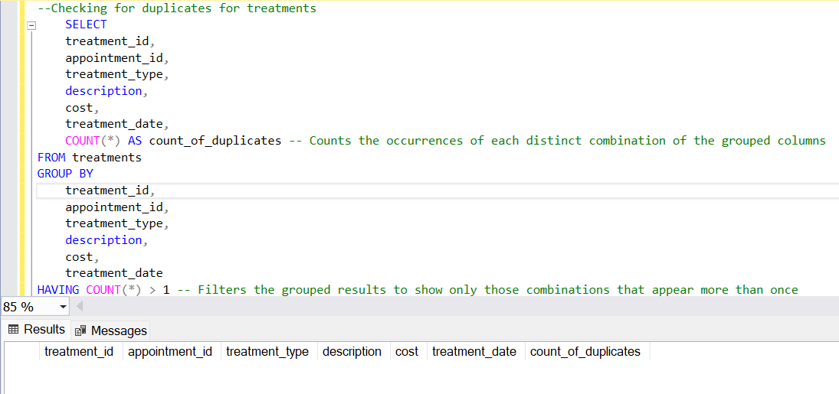
SQL Query for Checking for Duplicates in the Treatment Table and the same was done for the Patients, Doctor, Billing and Appointment tables

Slide 13
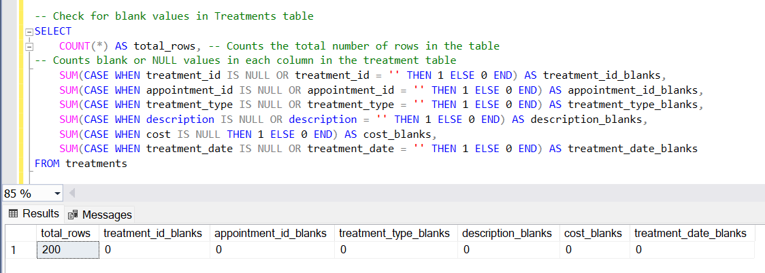
SQL Query for Checking for Blanks in the Treatment Table and the same was done for the Patients, Doctor, Billing and Appointment tables

Slide 14
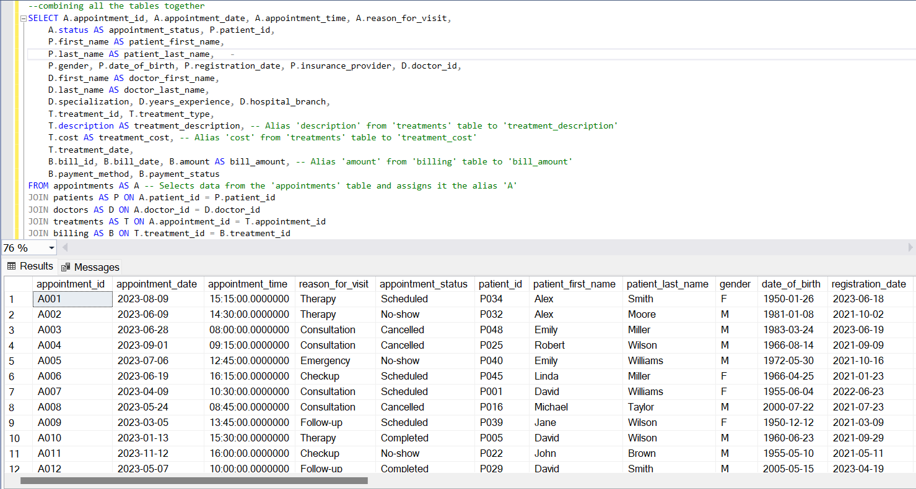
SQL Query for Joining all the Tables Together
Notes:
I selected all the column name from each table differentiating it by the alias name I gave to the tables from appointment table and joined on all the other tables

Slide 15
ANALYSIS AND FINDINGS
KEY PERFORMANCE INDICATORS (KPIs):
Average Bill Amount: $45.94k (shows average bill amount for the year)
Total Revenue: $551.25k (shows total revenue for the year)
Priciest Treatment Type: shows MRI as the priciest treatment type
Best Payment Method: Shows credit card as the best payment method

Slide 16
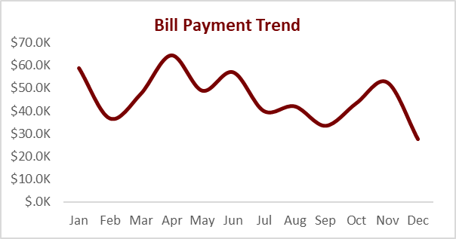
Bill Payment Trend
The line chart shows bill payment trend
Insights:
January and April have the highest bill payment while September and December have the least bill payment

Slide 17
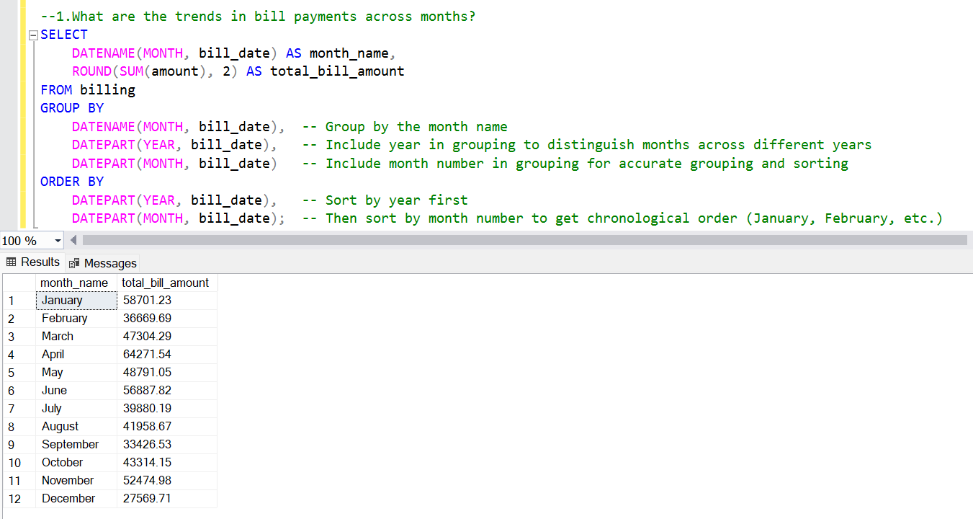
SQL Query For Bill Payment Across Months

Slide 18
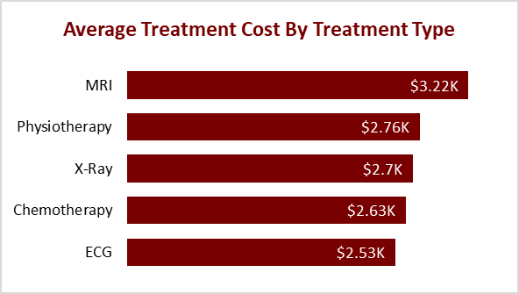
Average Treatment Cost by Treatment Type
The bar chart shows treatment cost by treatment type
Insights:
MRI and Physiotherapy have high treatment cost while ECG and Chemotherapy have the least treatment type.

Slide 19
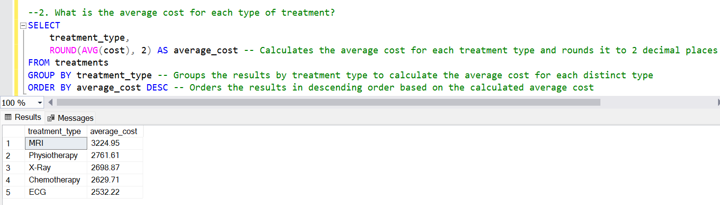
SQL Query For Average Cost For Each Type of Treatment

Slide 20
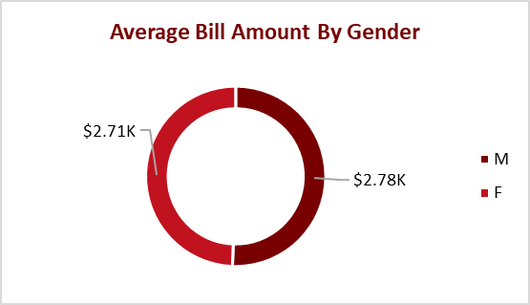
Average Bill Amount by Gender
The doughnut chart shows average bill amount by gender
Insights:
The average bill amount by gender shows males contributing $2.78K and females $2.71K. This shows that gender influences bill amount.

Slide 21
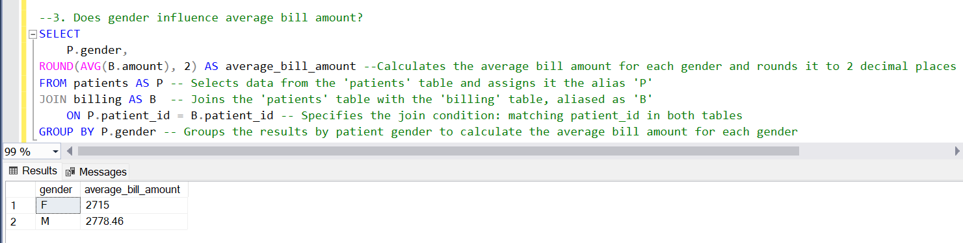
SQL Query For Average Cost For Each Type of Treatment

Slide 22
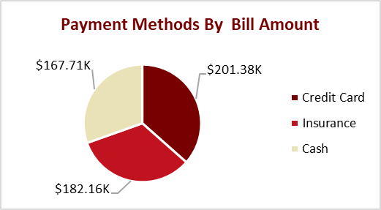
Payment Method by Bill Amount
The pie chart shows payment method by bill amount
Insights:
Credit card payments contribute the most to bill amounts ($201.38K), followed by Insurance ($182.16K) and Cash ($167.71K).

Slide 23
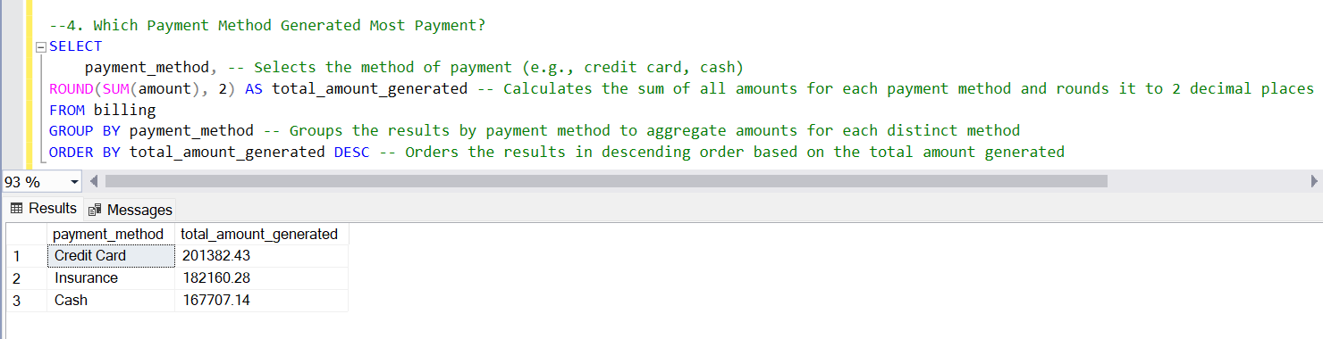
SQL Query For Which Payment Method Generated Most Payment

Slide 24
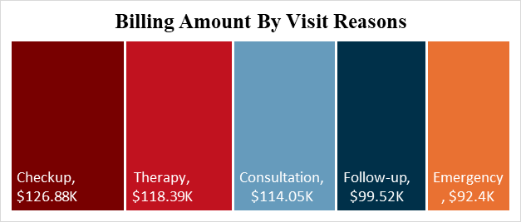
Billing Amount by Visit Reasons
The tree map chart shows billing amount by visit reason
Insights:
The highest billing amount by visit reason is "Checkup" at $126.88K, followed by "Therapy" at $118.39K and "Consultation" at $114.05K while emergency is the least at $92.4k.

Slide 25
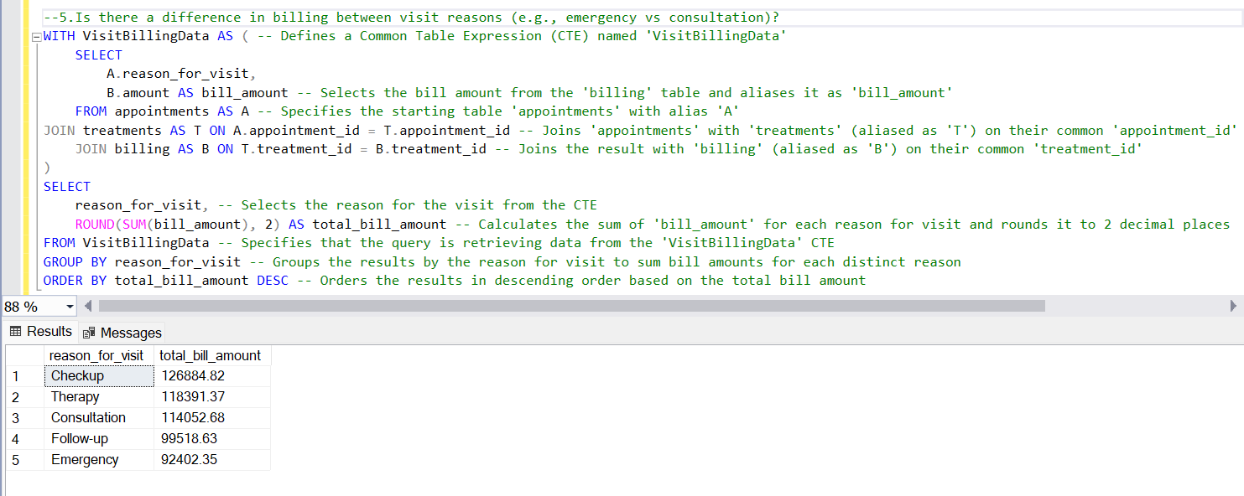
SQL Query For Is There a Difference in Billing Between Visit Reasons

Slide 26
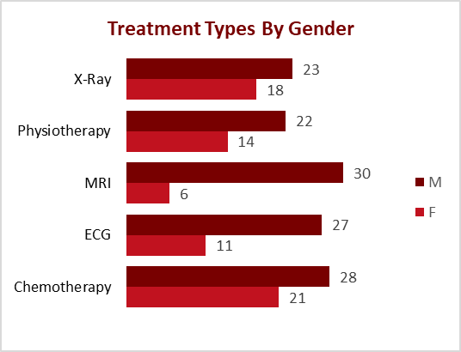
Treatment Types by Gender
The bar chart shows treatment type by gender
Insights:
For Males, MRI is the most common treatment type (30 cases) followed by Chemotherapy 28 cases then ECG 27 cases, X-Ray is performed 23 cases and Physiotherapy is performed 22 cases.
For Females, Chemotherapy is the most common treatment type (21 cases) followed by Xray 18 cases then physiotherapy 14 cases, ECG 11 cases and MRI 6 cases.

Slide 27
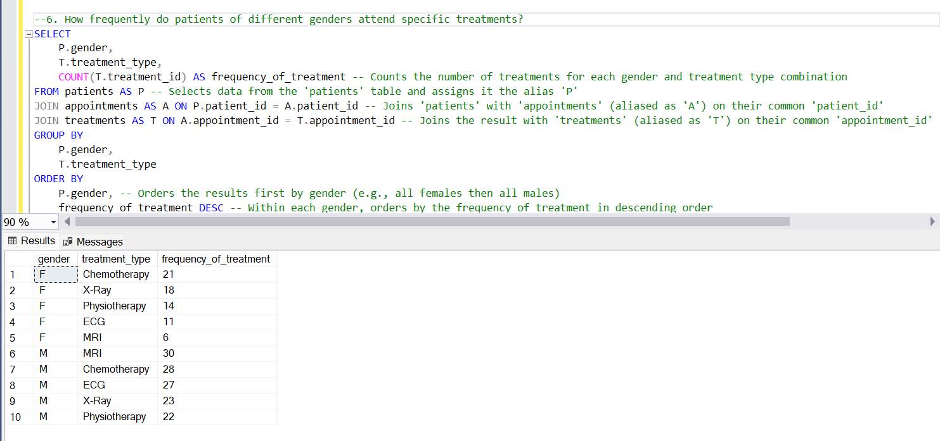
SQL Query For How Frequently Do Patient of Different Genders Attend Specific Treatments

Slide 28
RECOMMENDATION
Launch Seasonal Health Packages: Offer bundled services (e.g., checkups + therapy) during slower months to boost patient volume and stabilize revenue.
Optimize MRI Usage & Pricing: Introduce flexible MRI pricing options and review clinical necessity to manage costs and increase accessibility.
Promote Digital & Insurance Payments: Encourage credit card and insurance use through partnerships and installment plans to improve cash flow and billing efficiency.
Run Gender-Based Campaigns: Tailor outreach based on patient behavior—e.g., wellness campaigns for women, screening drives for men—to increase engagement.
Invest in High-Performing Departments: Expand Pediatrics (highest revenue) and improve digital infrastructure in Dermatology and Oncology for greater efficiency.
Use Predictive Analytics: Build a dashboard to forecast seasonal demand and monitor underperforming departments for proactive planning.
Boost Preventive Care in Low Seasons: Offer discounted or incentive-based preventive services during slow months to maintain steady patient visits.

Slide 29
CONCLUSION
The hospital is generating strong revenue overall ($551.25K), with checkups, therapy, and consultations being the top revenue-driving visit types. MRI remains the priciest treatment heavily influencing bill amounts across all categories. Gender, specialization, and seasonality all impact billing trends and revenue. Digital payment (especially credit cards) is the preferred method, although cash still plays a major role in pediatrics. There are clear seasonal patterns in billing that can inform resource allocation and strategic planning. Male patients tend to incur higher treatment costs and generate more revenue, while different specializations perform unevenly.

Slide 30
THANK YOU

